Slide 1

Modelling Continuous Outcome:
Linear regression
Kamarul Imran Musa
Assoc Prof (Epidemiology and Biostatistics)

Slide 2


Objectives of lecture
At the end of the lecture, students will be
Able to model continuous outcome variable using multiple linear regression
Able to perform model assessment
Able to interpret model

Slide 3

Introduction
We analyze data
To explain relationship between variables
To estimate the effect of a set of variables (predictors) onto another variable (the outcome)
To make inference – how large the effect?
To predict the outcome based on new data

Slide 4

Estimation and Inference
To estimate =
A process by which one makes inferences about a population, based on information obtained from a sample.
Making inference =
the reasoning involved in drawing a conclusion or making a logical judgment
on the basis of circumstantial evidence and prior conclusions
Not only on the basis of direct observation

Slide 5
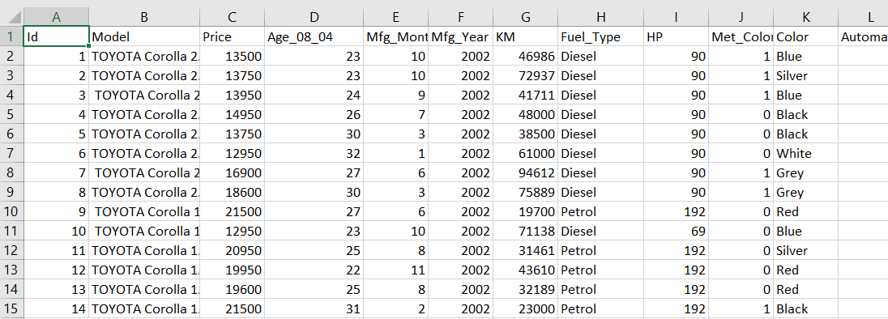
Data
Variables
Numerical
Integer
Double
Categorical
Character
Factor
Row => Observations
Columns => Variables

Slide 6
Questions
Give example of outcome relevant to your area that you may study
State the objective of the analysis
Are the data suitable for linear regression analysis?

Slide 7
Motivation
When outcome is numerical, the common analysis for making inference or prediction is linear regression
Inference = explanation
What is the aim?
To explain vs to predict
In statistics, to explain is more common
Interested in the beta
In analytics, to predict is more common
Not interested in beta, but interested to predict the outcome

Slide 8
Outcome variable
Also known as the
Response variable
Target variable
Dependent variable
When the outcome is numerical (in the form of continuous), we model using linear regression
For example :
Price of car <- year + mileage + hp + colour + ….
Satisfaction score of clients <- age + sex + price + after_sale + …..

Slide 9

Model: Simple Linear Regression
Simple linear regression model
$Y_{i}= β_{0}+ β_{1}x_{i}+ e_{i}$
Where
$β$ = Beta = coefficients
$e$ = Epsilon = error or noise

Slide 10
Regression equation
Regression equation
Regression coefficients
Methods to obtain the coefficients = ordinary least square
Why ordinary least squares?
To estimate the best coefficients
To obtain the smallest difference between the observed and the estimated outcome = smallest Mean Square Error (MSE)

Slide 11
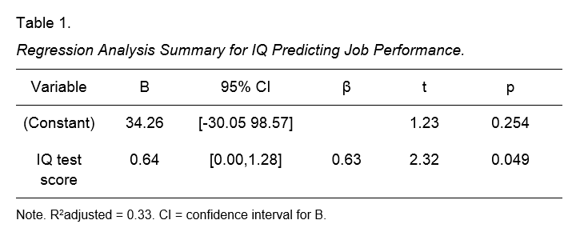
Model: Simple Linear Regression
One predictor or covariate or independent variable
https://www.spss-tutorials.com/spss-simple-linear-regression-tutorial/

Slide 12

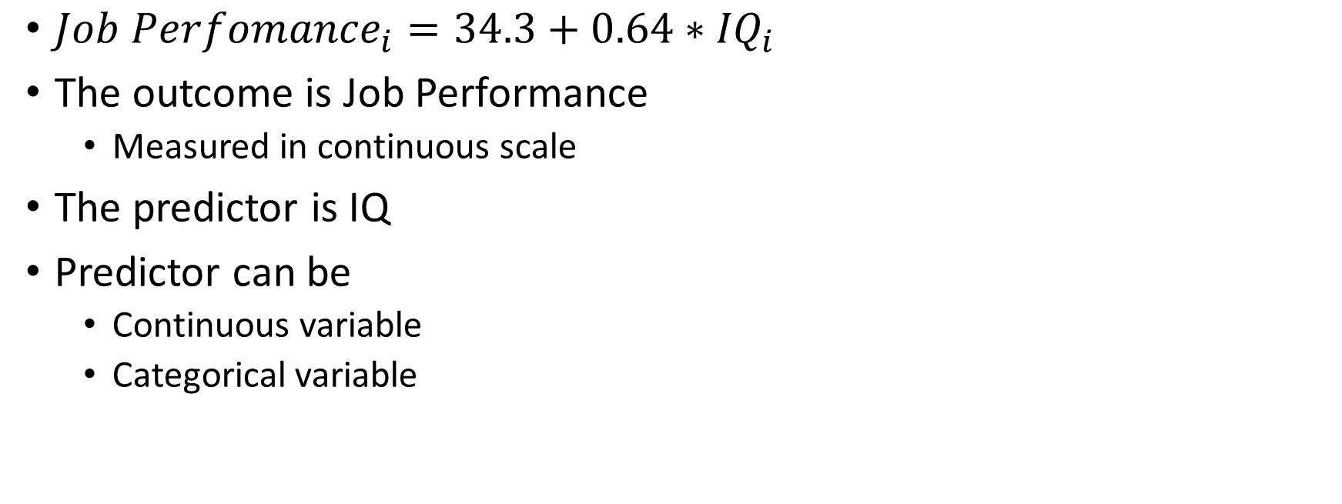
Equation: SLR example
${Job Perfomance}_{i}=34.3+0.64∗{IQ}_{i}$
The outcome is Job Performance
Measured in continuous scale
The predictor is IQ
Predictor can be
Continuous variable
Categorical variable

Slide 13
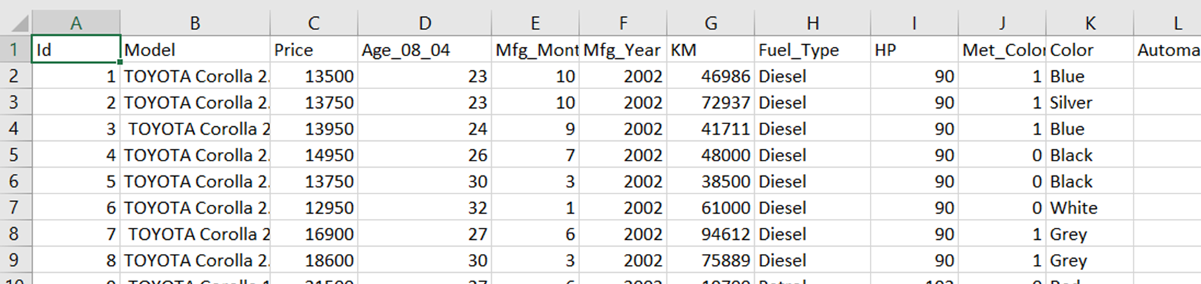
SLR
What is variable (outcome) of interest?
Which variable explain the outcome of interest?
How strong the explain the outcome of interest?

Slide 14
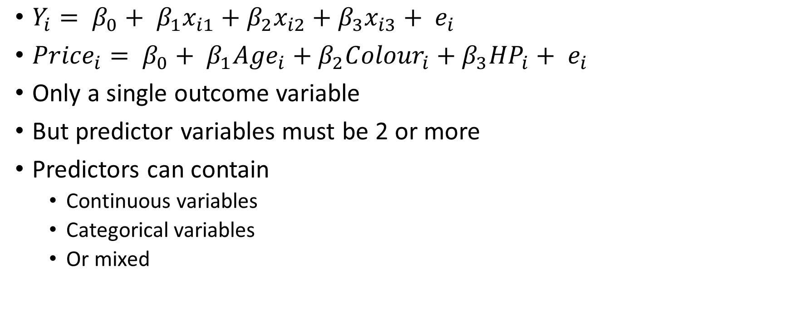
Model: Multiple Linear Regression
$Y_{i}= β_{0}+ β_{1}x_{i1}+β_{2}x_{i2}+β_{3}x_{i3}+ e_{i}$
${Price}_{i}= β_{0}+ β_{1}{Age}_{i}+β_{2}{Colour}_{i}+β_{3}{HP}_{i}+ e_{i}$
Only a single outcome variable
But predictor variables must be 2 or more
Predictors can contain
Continuous variables
Categorical variables
Or mixed

Slide 15
Model: Multiple Linear Regression
Outcome: Gasoline sold (thousands of gallons)
4 predictors or independent variables
Source: Sanford Weisberg. Applied Linear Regression. Wiley. 2013

Slide 16
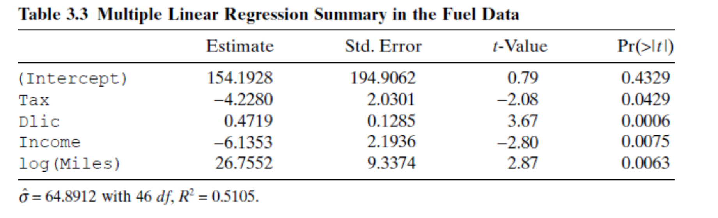
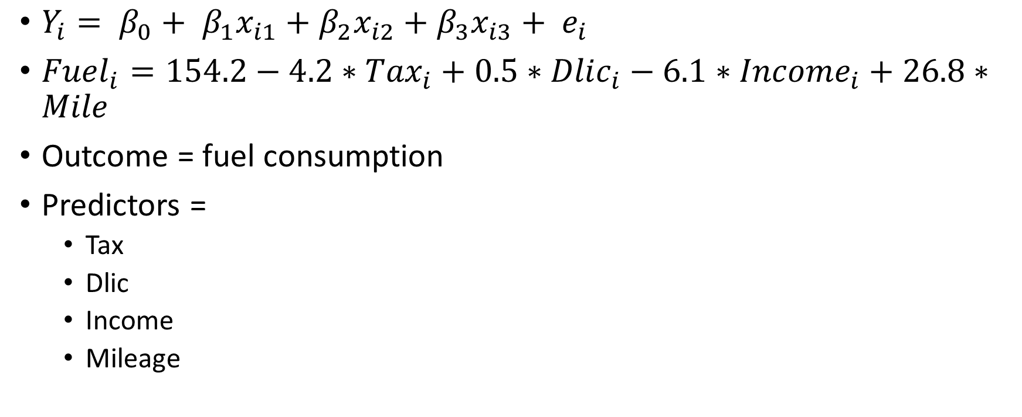
Equation: MLR example
$Y_{i}= β_{0}+ β_{1}x_{i1}+β_{2}x_{i2}+β_{3}x_{i3}+ e_{i}$
${Fuel}_{i}=154.2−4.2∗{Tax}_{i}+0.5∗{Dlic}_{i}−6.1∗{Income}_{i}+26.8∗Mile$
Outcome = fuel consumption
Predictors =
Tax
Dlic
Income
Mileage

Slide 17
Age of cars
KM
Price of car
Fuel Type
Color of cars
Weight of car

Slide 18
Assumptions for linear regression
Assume that the outcome in the population for given predictors follows normal distribution (N)
The relationship between the outcome in the population and the predictors is linear (L)
The observations are independent between one another (I)
The variability in the outcome in the population for given predictors is similar in all values of the predictors (E)
Homoscedasticity: The variance of residual is the same for any value of X.

Slide 19
Questions
What would be the predictors for your linear regression model?
What are the types of each predictor?
Why do you choose those predictors?
What are your hypotheses?

Slide 20
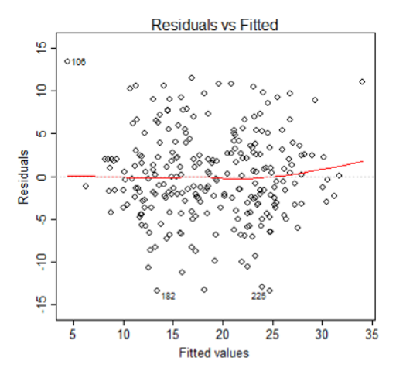
Model assessment

Slide 21
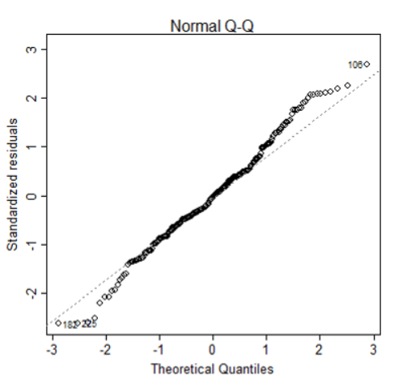
Model assessment: fitness
Assumption of normality.
The normality assumption is evaluated based on the residuals and can be evaluated using a QQ-plot
Comparing the residuals to "ideal" normal observations.
Observations lie well along the 45-degree line in the QQ-plot, so we may assume that normality holds here.

Slide 22
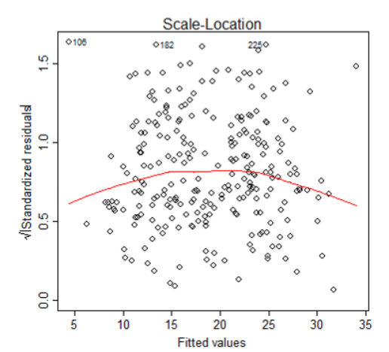
The third plot is a scale-location plot (square rooted standardized residual vs. predicted value).
This is useful for checking the assumption of homoscedasticity.

Slide 23
Presenting linear regression results
Table: Relationship between predictors and satisfaction score, n= 356
Predictors | beta | 95% CI | P-value
Intercept | 10.2
Age | 1.3 | 1.0,1.6 | 0.030
Male | 5.6 | 5.4,5.8 | 0.021
Income (per 500) | 2.4 | 1.8,3.0 | 0.001
Household size | -3.5 | -5.0,-2.0 | 0.040
Ref group – female R-squared = 0.68

Slide 24
Interpretation
Intercept – we don’t interpret
If age increase by 1 year then satisfaction score increase for 1.3 unit (95% CI: 1.0,1.6)
Male has 5.6 unit higher satisfaction score than female customers (95% CI: 5.4,5.8)
If income of customer increases for RM500 then the satisfaction score increase for 2.4 unit (95% CI: 1.8, 3.0)
Family with 1 more household size has 3.5 unit lower score (95% CI :
-5.0, -2.0)

Slide 25
Home-work
Find a dataset
Identify variable of interest (outcome)
Choose potential predictors variables
Estimate the regression coefficients, confidence intervals and p-values
Interpret the coefficients (beta’s)

Slide 26
References
http://sphweb.bumc.bu.edu/otlt/MPH-Modules/BS/R/R5_Correlation-Regression/R5_Correlation-Regression7.html

